Slide 1
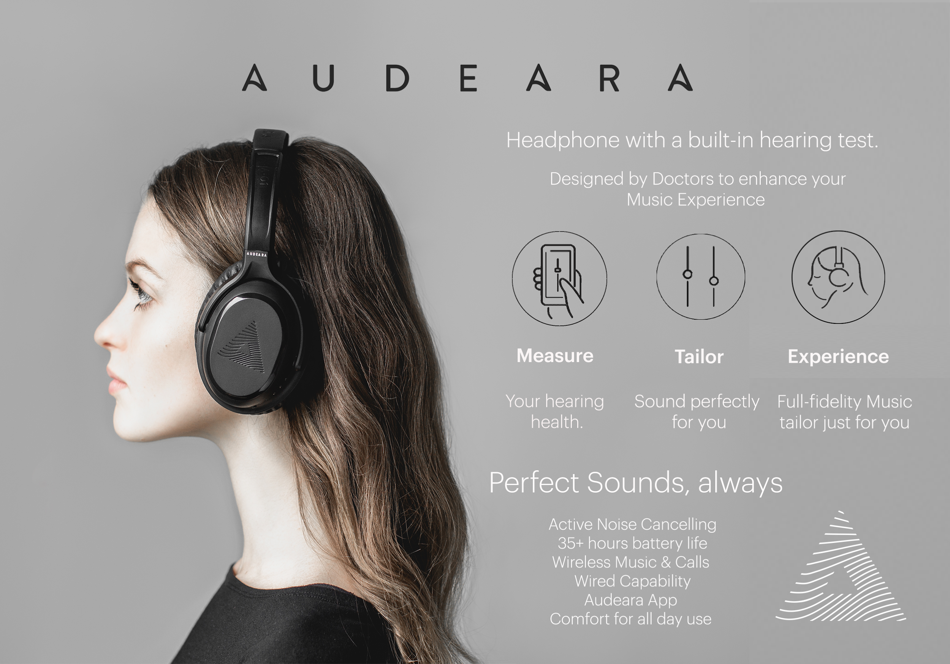
AUDEARA
HALEY
TINA MA
MIKEY
MADDISON
JOHN

Slide 2
OUTLINE
AUDEARA’S BACKGROUND
AUDEARA’S PROBLEM
IDENTIFYING CURRENT TARGET AUDIENCE AND SITUATION
COMPETITIVE POSITION
STRATEGY FORMULATION
RECOMMENDED STRATEGIES
PROJECT PLAN AND TIMELINE

Slide 3
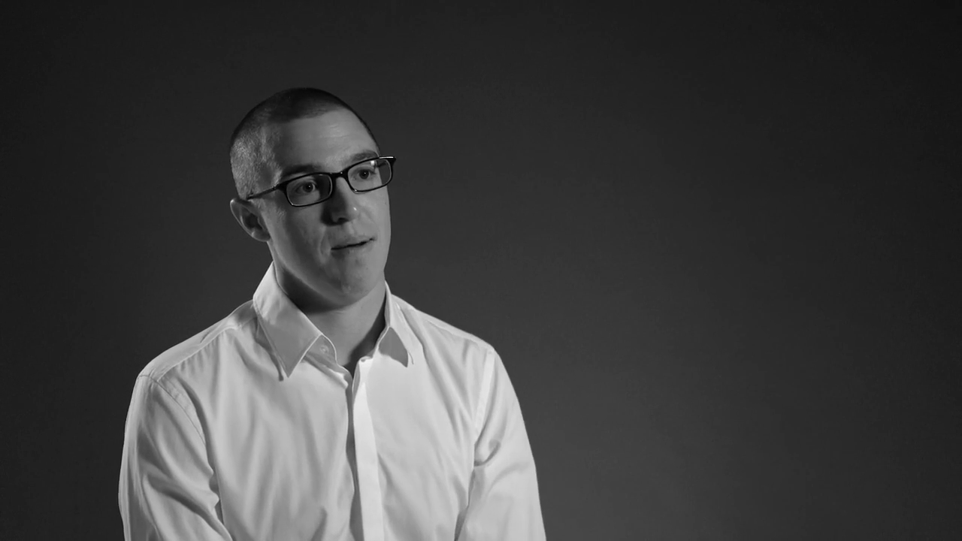

Slide 4



THE PROBLEM
LOOKING TO FOCUS ON GAINING A LARGER MARKET SHARE BY ATTRACTING MILLENNIAL MORE SPECIFICALLY, UNIVERSITY STUDENTS
VERY COMPETITIVE INDUSTRY: COMPETITORS INCLUDING BOSE, SONY, AND BEATS
AUDEARA’S SOURCE OF COMPETITIVE ADVANTAGE IS THEIR MEDICAL PERSPECTIVE, BUT MILLENNIALS MAY SIMPLY NOT CARE
NEED TO INFLUENCE MILLENNIALS TO BUY INTO THE BRAND’S MESSAGE AND IDEA

Slide 5
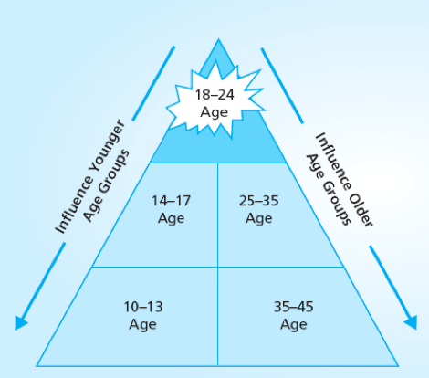
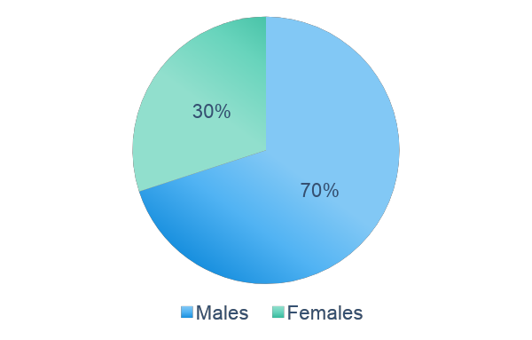
The Targeted Audiences
Audeara Current Users
Aged from 25 - 35 yrs
Intended Target Users

Slide 6
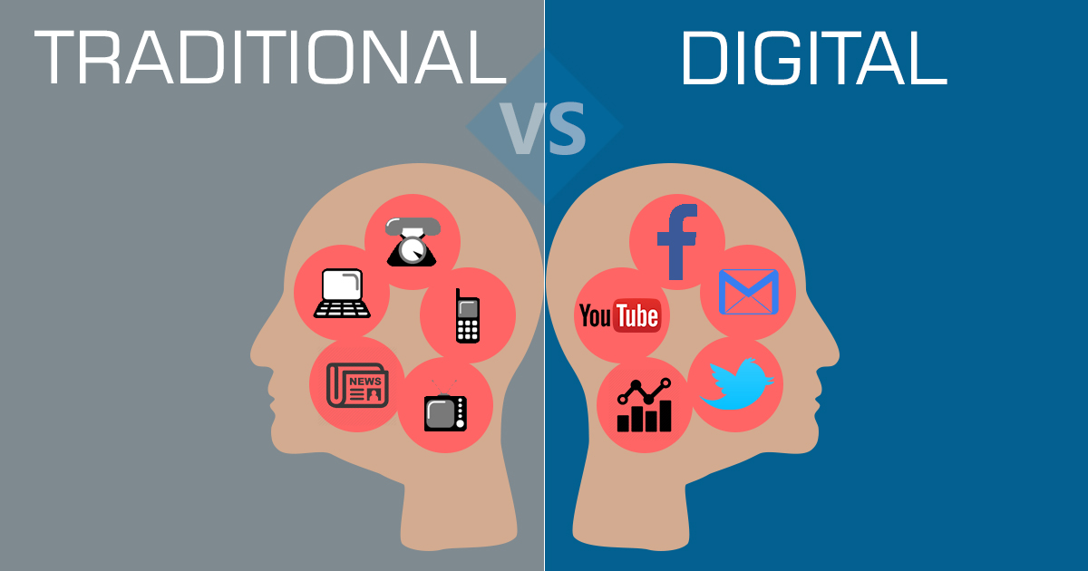
CURRENT STRATEGIES
Marketing
Traditional Marketing
Digital Marketing
Press outreach
music & tech conferences
Networking
social media /Banner ads /search marketing
online & offline Marketing campaigns
Radio advertising / Online stream

Slide 7
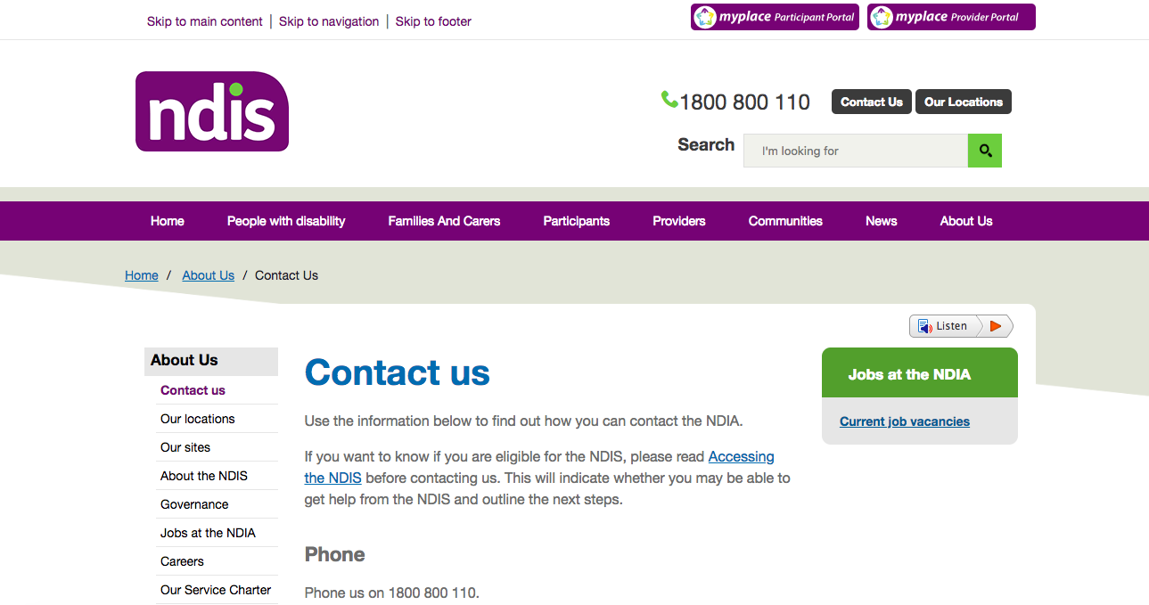

Current Situations

Slide 8
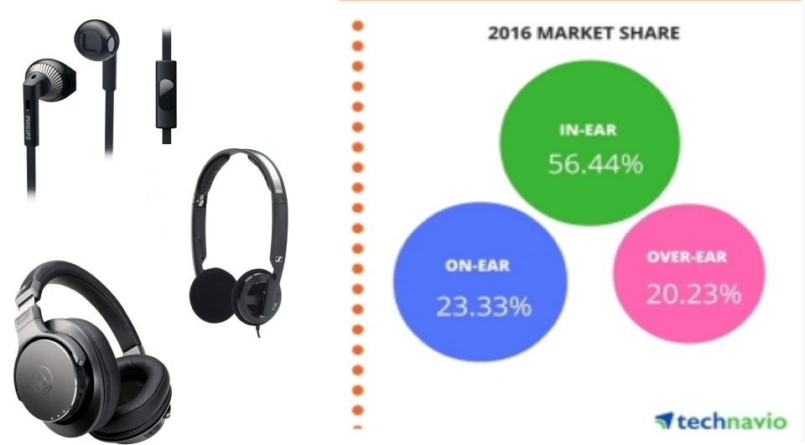

Slide 9
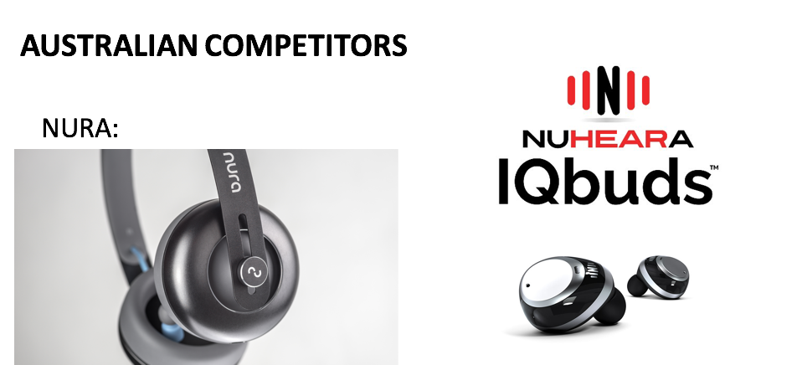

Slide 10
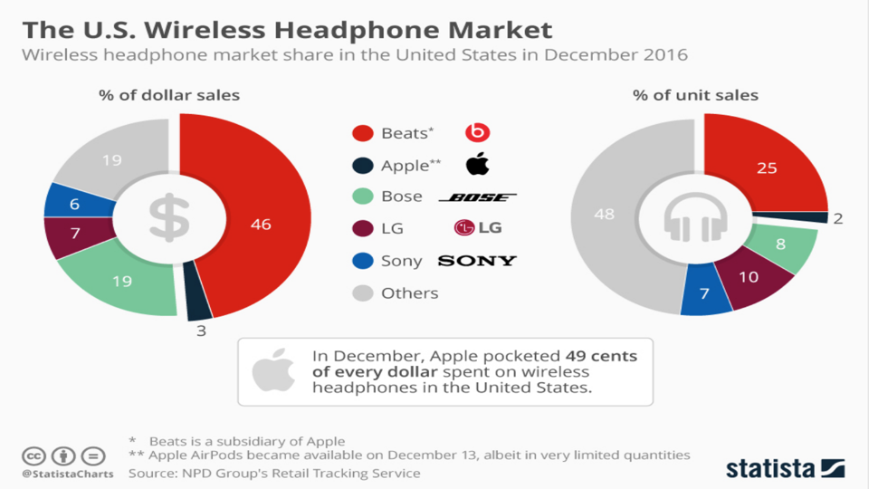

Slide 11
Brand | Model | Threshold Hearing Test | Track Hearing Health | App |  | ANC | Tailored Sound | Battery Life | RRP (AUD)
 |  |  |  | Customisable / Controllable | Record user data |  |  | B/T + ANC | $
Audeara | A-01 | ✔ | ✔ | ✔ | ✔ | ✔ | ✔ | 20 | 499
Nura | Nura | x | x | ✔ | ✔ | ✔ | ✔ | 20 | 429
Nuheara | IQBuds | x | x | ✔ | x | ✔ | x | 4 | 399
SONY | WH-1000MX2 | x | x | ✔ | x | ✔ | x | 30 | 499
BOSE | QC35 | x | x | ✔ | x | ✔ | x | 20 | 499
BEATS | Studio Wireless | x | x | x | x | ✔ | x | 12 | 479
SENNHEISER | Momentum 2.0 | x | x | ✔ | x | ✔ | x | 22 | 799
Audio Technica | ATH-DSR9BT | x | x | x | x | x | x | 20 | 899

Slide 12
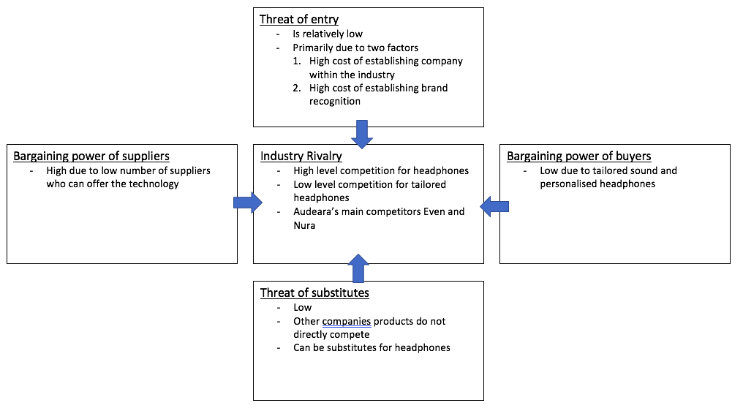
PORTERS FIVE FORCE MODEL

Slide 13
SWOT ANALYSIS - AUDEARA
Strengths Designed by Doctors & engineers Tailored sound First in the market Innovative & highly sophisticated product | Weakness Lack of brand awareness and trust 15 minute test High price Product range narrow compared to competitors
Opportunity Lack of competitors Hearing impaired patients Design of product After pay Promotions | Threats Large competitors ie, Sony and Beats Rising manufacturing costs

Slide 14
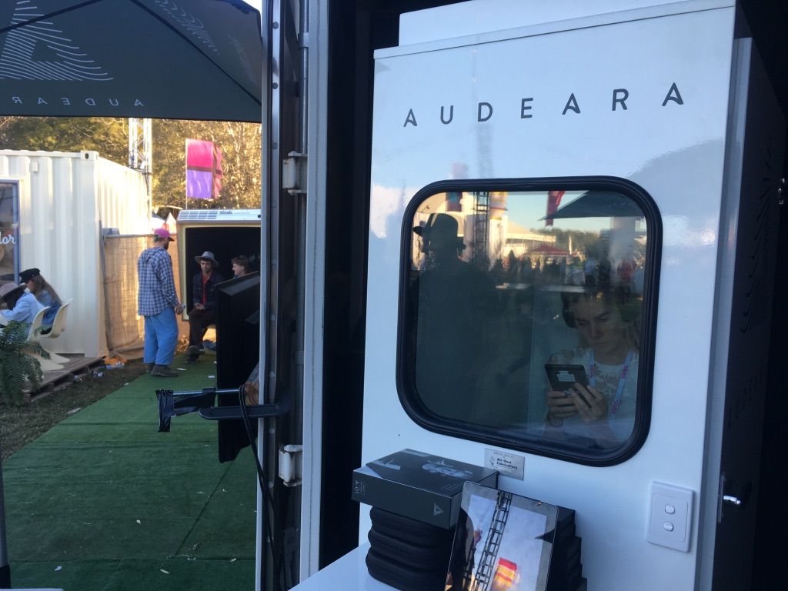
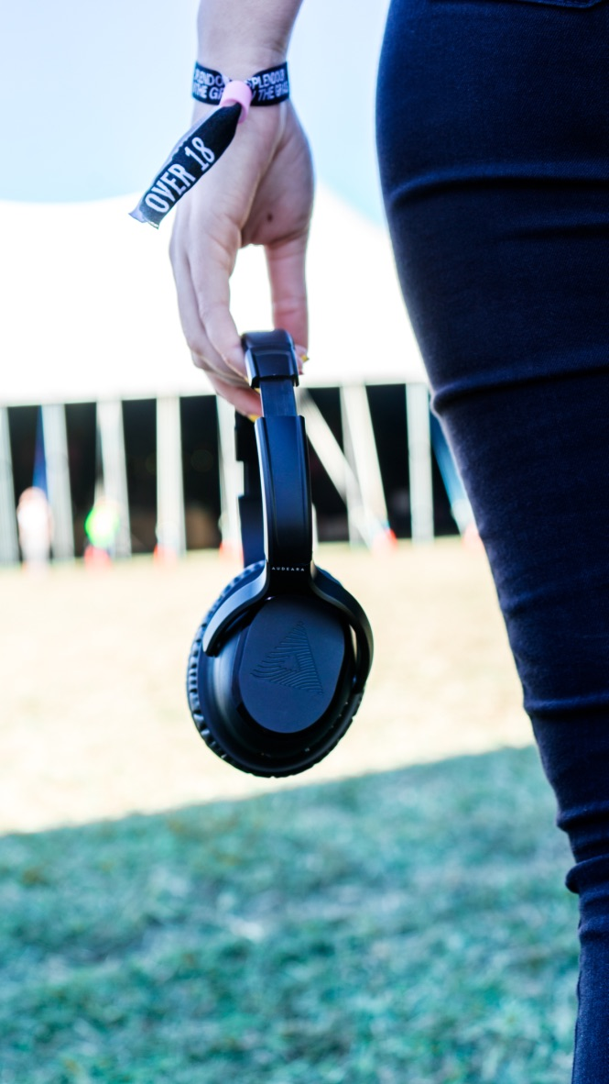
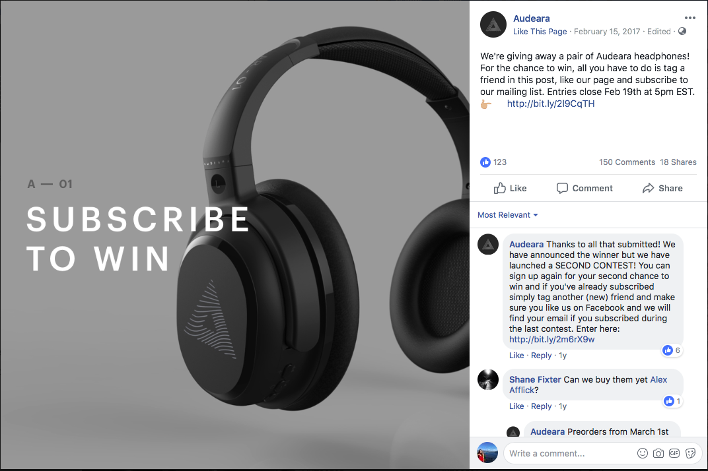
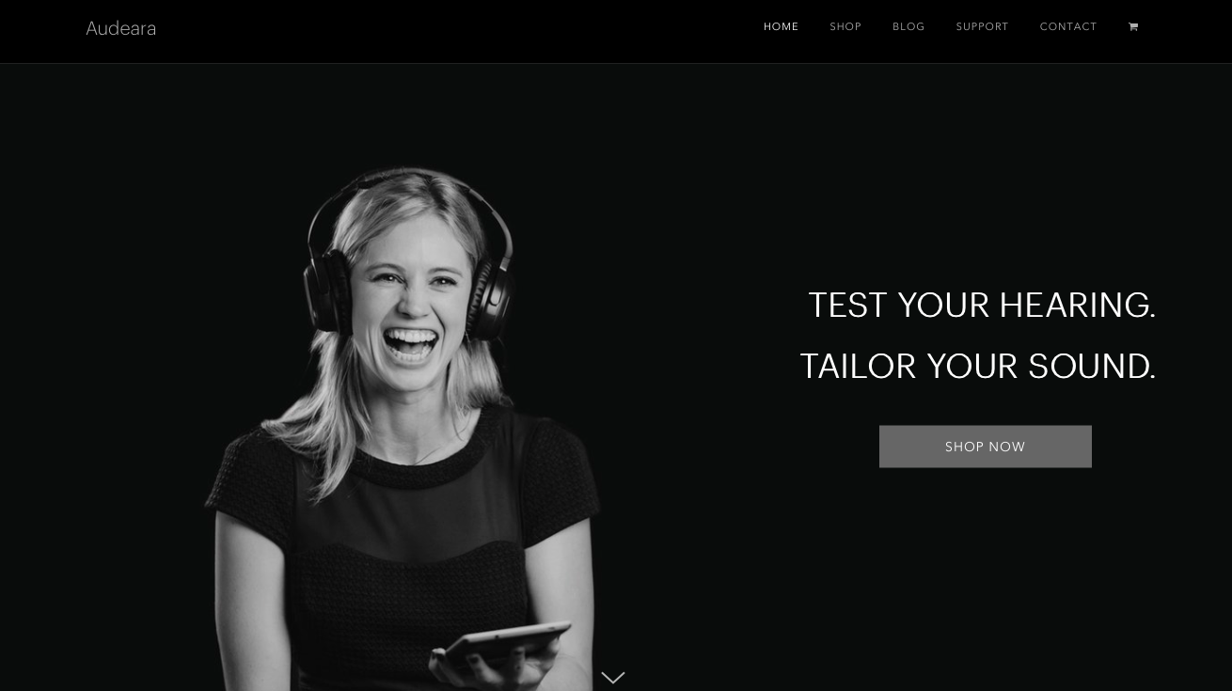
MARKETING MATERIALS

Slide 15
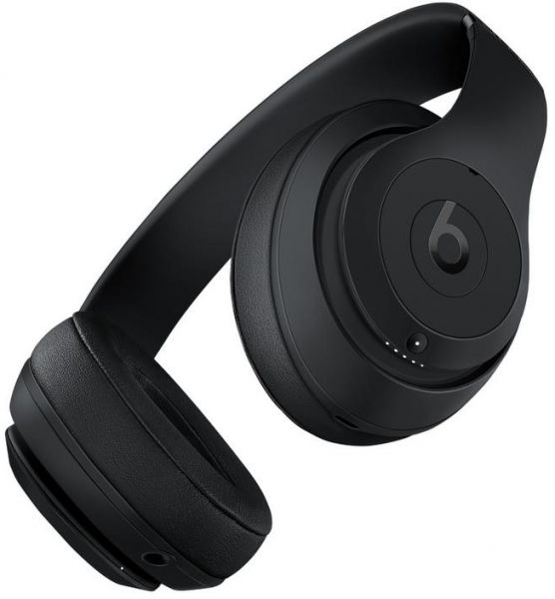
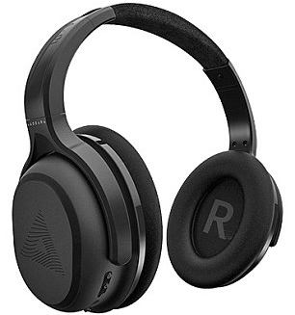
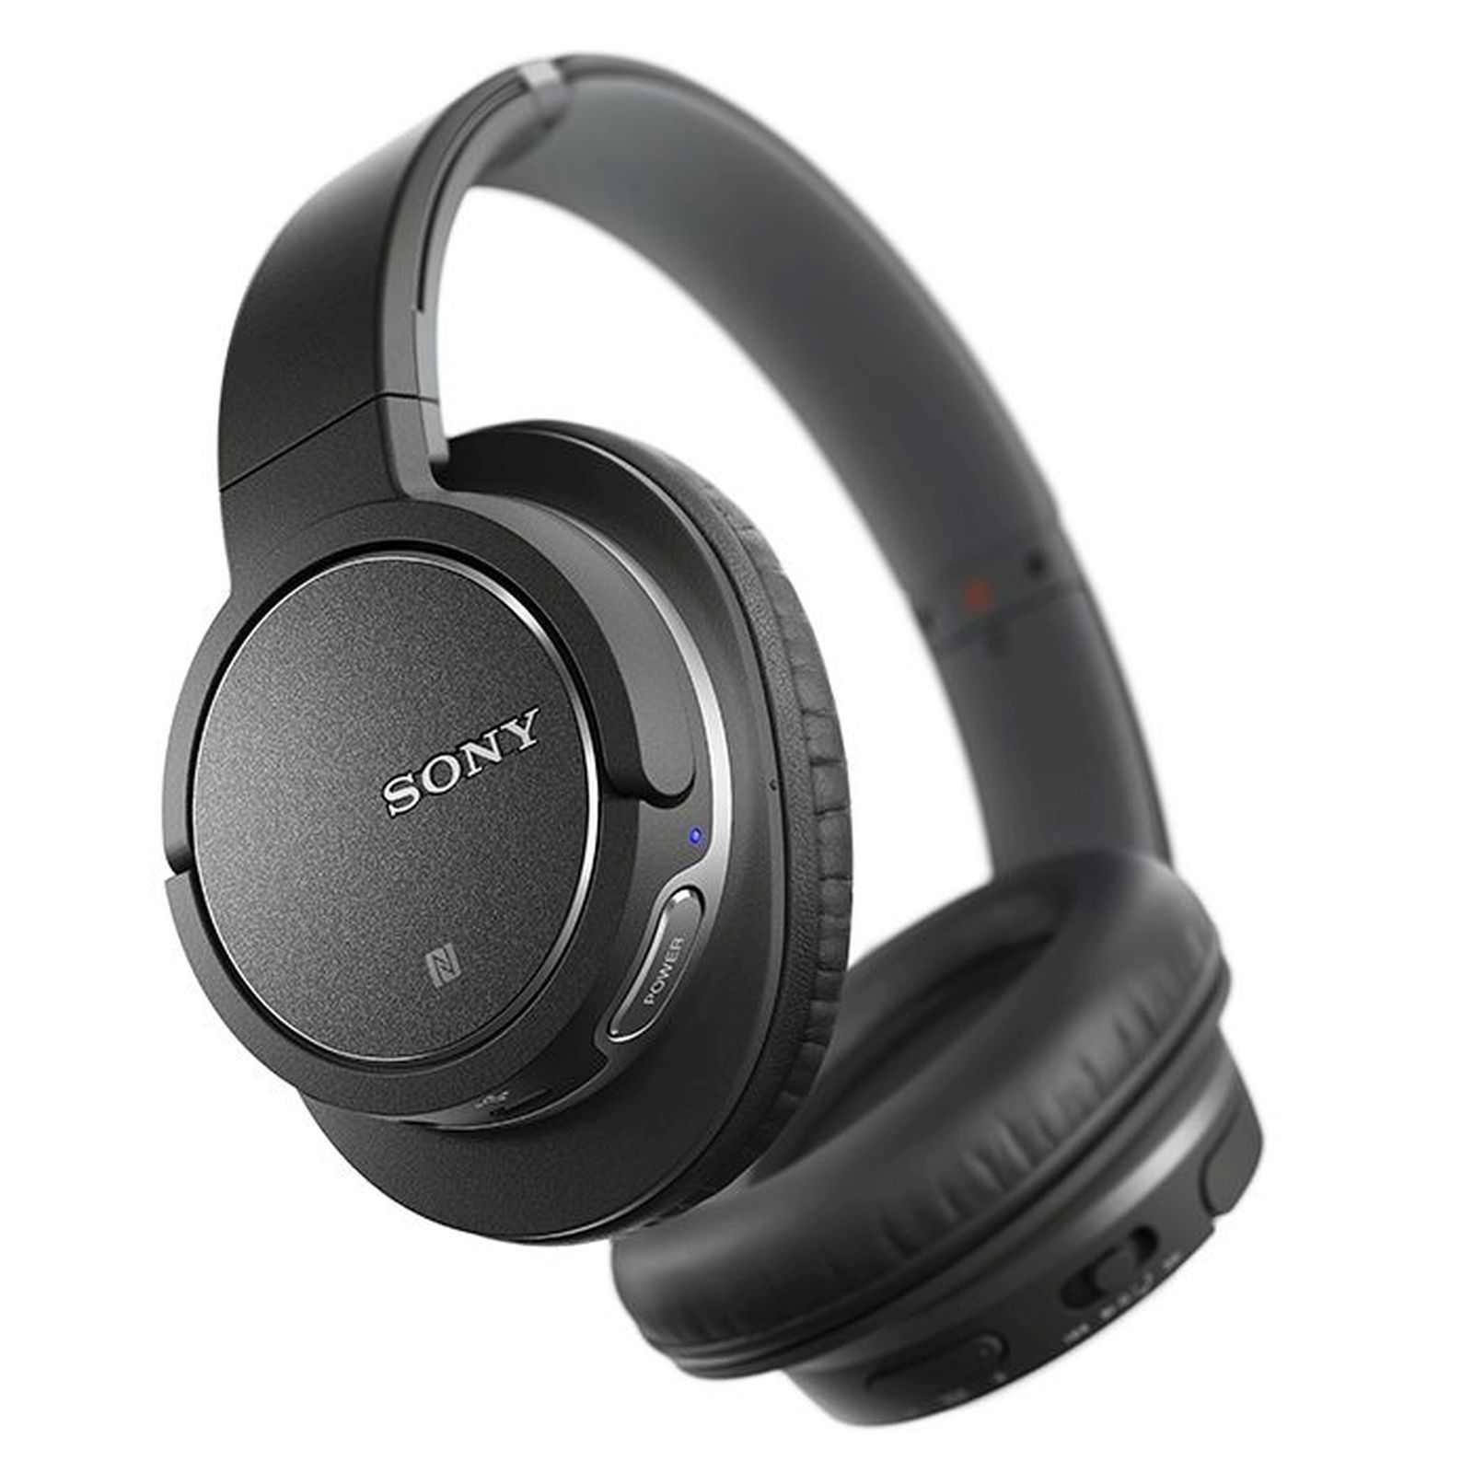
THE SOLUTION: OUR IDEAS
THREE PURCHASE MOTIVES:
PRICE:
WE RECOMMEND A 10% STUDENT DISCOUNT THROUGH MY UNIDAYS AS WELL AS THE USE OF AFTERPAY
ASSURANCE OF BENEFITS:
SETTING UP A TESTING BOOTH FOR PASSERSBY TO TAKE THE HEARING TEST AND NOTICE THE DIFFERENCE
TAKING THIS TO MUSIC FESTIVALS (E.G. SPLENDOUR IN THE GRASS AND BIGSOUND) AND UNIVERSITY OPEN DAYS
APPEARANCE:
CURRENTLY QUITE GENERIC
POSSIBILITY TO OFFER NUMEROUS COLOURS AND TEXTURES

Slide 16
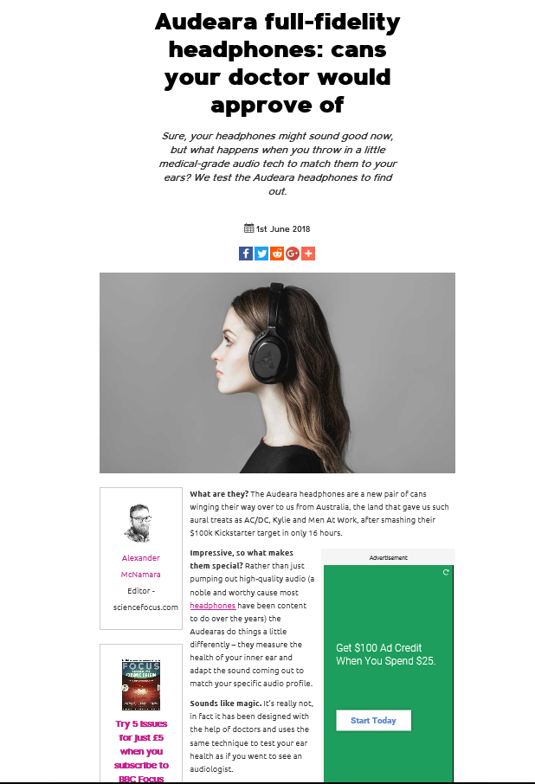
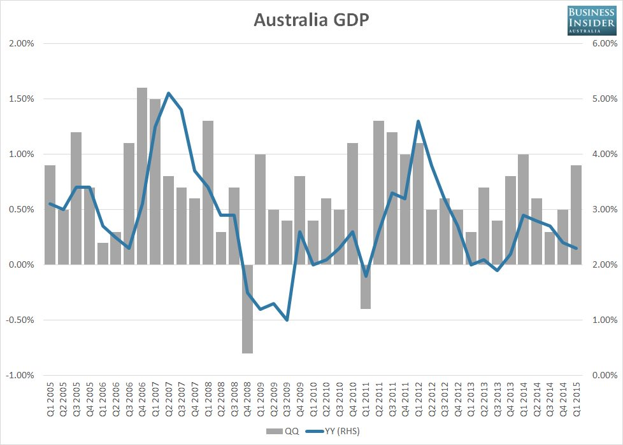
INFORMATION REQUIRED
CHANGE IN ECONOMIC GROWTH
NEWS AND ARTICLES ABOUT OUR COMPANY
OTHER COMPANY’S EXAMPLE OF PROBLEM SOLVING
CUSTOMER RESPONSES AND FEEDBACK POINT AFTER USE OUR PRODUCT

Slide 17
PLAN AND TIMELINE
FIND THE MARKETING OBJECTIVE
ANALYZE MARKET AND COLLECT INFORMATION WHAT WE NEED
ESTABLISH STRATEGY
REVIEWING ESTABLISHED STRATEGY
IMPLEMENT THE PROBLEM SOLUTION
Detect market objective
Collect data
Establish strategy
Reviewing strategy
Implementation

